Slide 1
camera
写真
Hardware
回路
5.0V

Slide 2
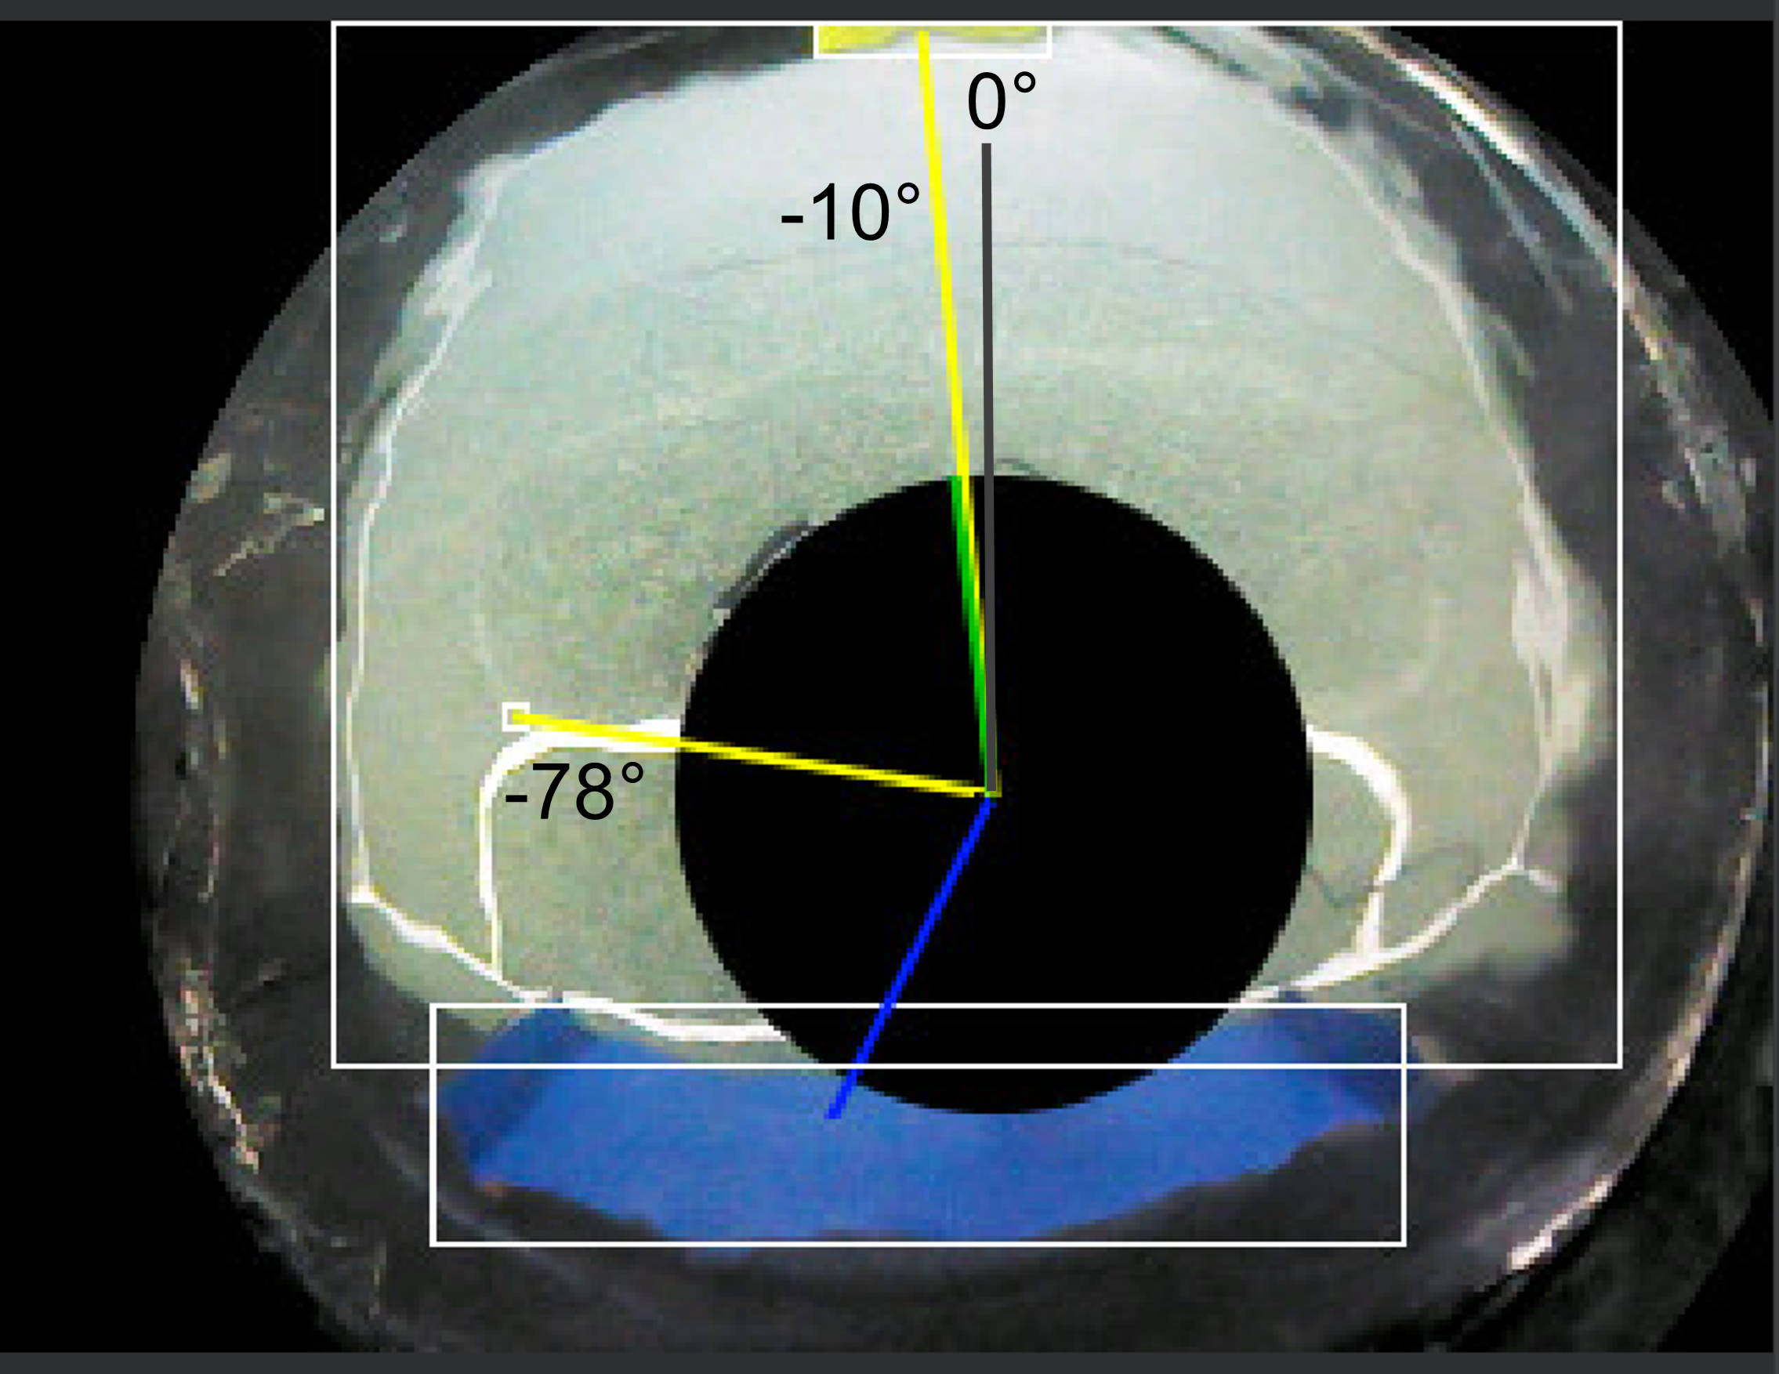
Software

Slide 3
Software

Slide 4
Software

Slide 5
Software

Slide 6
Software

Slide 7
Software

Slide 8
Software

